Slide 1

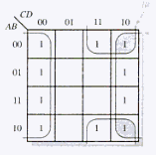

Slide 2


Slide 3
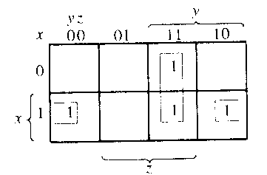

Solution

Slide 4


Slide 5
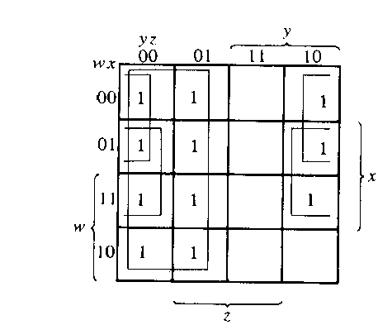

Solution

Slide 6


Slide 7
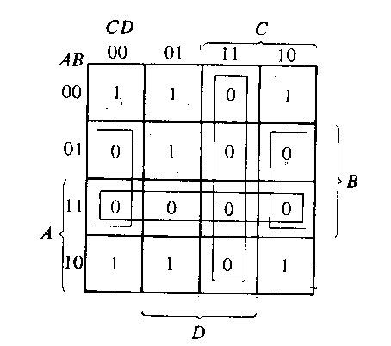


solution

Slide 8


Slide 9
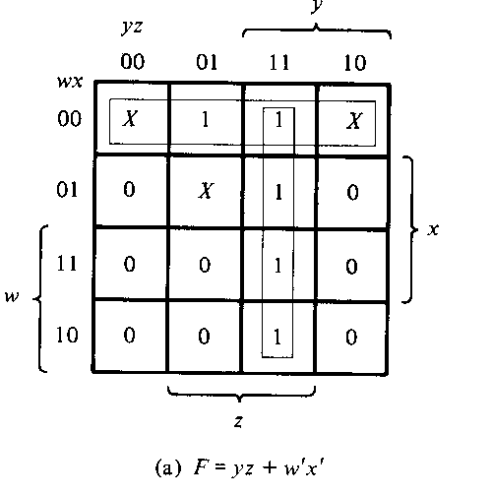
Solution

Slide 10
